Slide 1
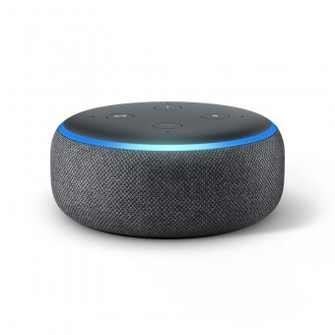
Alexa Print Project
COSC 439
Maximilian Moore
Nathan Cox
Kevin Valle

Slide 2
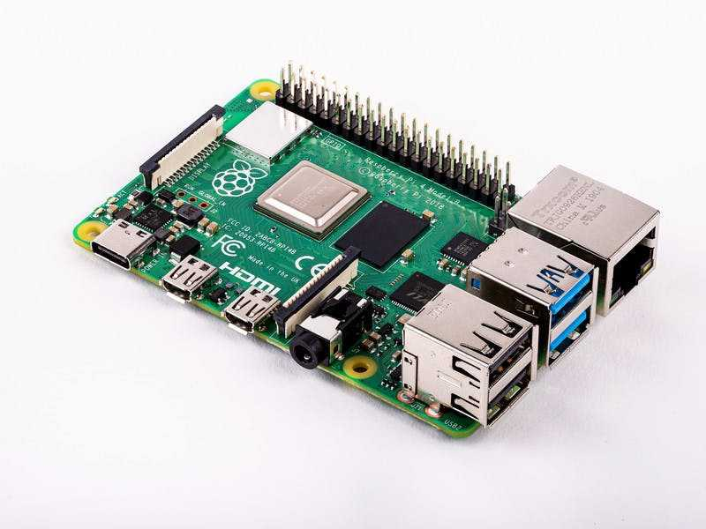
Project Objective / Overview
We will use a raspberry pi to create a print server that can be controlled with Alexa commands.
Alexa Skill → Pi → Printer → Audible commands
Realistic uses:
Printing common documents such as resumes and cover letters.
Streamline the process for less tech savvy people.
College students running late and need to print without pulling out their laptop.
Print a document for a friend or family member when you are not home.
Notes:
An alexa skill will send instructions to the raspberry pi, which is connected to a printer, enabling it to print files with audible commands from wherever you may be.

Slide 3

Work Distribution and Details
Research and find needed resources - Kevin
Server → Request → Pi
We found a couple different approaches:
Using an S3 bucket through AWS
Using a DynamoDB
Creating a Webserver on the Pi
And sending the JSON object straight to the Pi
Set up an Alexa Development console
Notes:
Build our understanding of how to create a server to send our request to our raspberry pi.
Based on our research, we have decided to create a web server using a CGI HTTP Server & routing it through NGROK

Slide 4

Work Distribution and Details (Cont’d)
2. Acquire the following components - Max, Nathan, Kevi n
Printer
Alexa Capable Device
Raspberry Pi
Create Repository
3. Research how the following software runs - Max, Nathan, Kevin
Common Unix Printing System (CUPS)
Executable CGI script on the Pi
Ngrok
Alexa Skill Development
File Searcher on the Pi
Notes:
CUPS → We had to change the cups configure file to get the software to work with the PI.
File Searcher → Create a program that will take the document string and search the pi files for a match or to return false if the document is not present.

Slide 5
Work Distribution and Details (Cont’d)
4. Configure the Raspberry Pi with Rasbian - Nathan, Max
5. Install Common Unit Printing System (CUPS) - Nathan
6. Add the Printer to CUPS - Nathan, Kevin
7. Create the Alexa Skill- Nathan, Max
8. Set up a webserver on the Raspberry Pi - Nathan
9. Write a file searcher -Max

Slide 6


Work Distribution and Details (Cont’d)
7. Test Product - Kevin, Max, Nathan
8. Troubleshoot / Debug - Max, Kevin, Nathan
9. Final Touches - Kevin, Max, Nathan
Notes:
Test the Product -
Test 1: Give Alexa voice commands to print a document on the computer.
Test 2: Give Alexa voice commands to print a document that is not on the computer.
Test 3: Give Alexa a command to print a file type such as an mp3 file that cannot be printed.
Troubleshoot / Debug -
Use the debugger in the Alexa development console.
Troubleshoot by using the interactive environment in Alexa console.
Final Touches -
Ensure that we have responses for all possible scenarios in the Alexa skill.
Remove any redundant code.

Slide 7
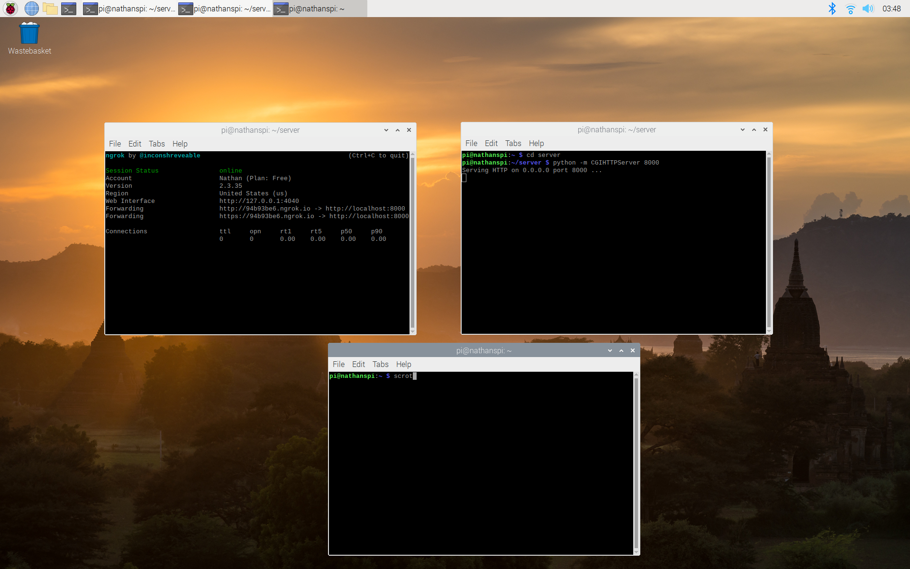
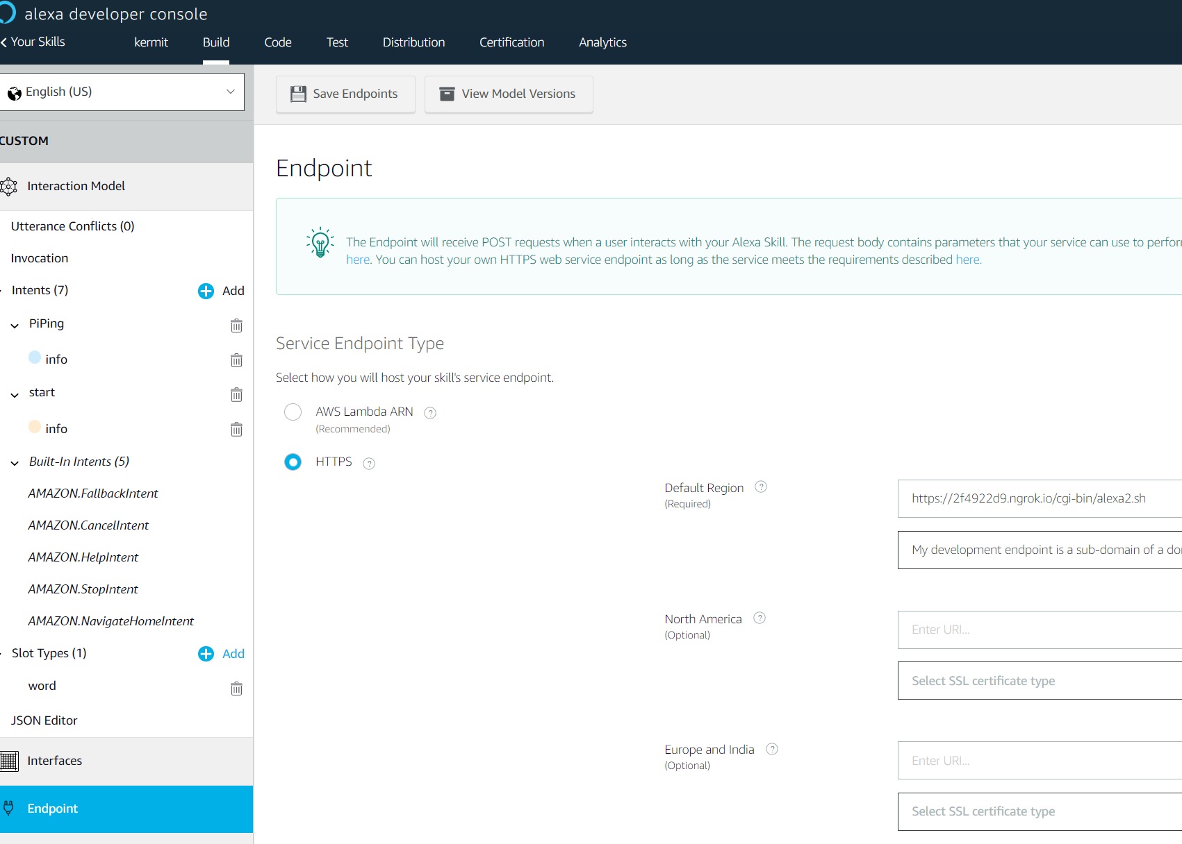
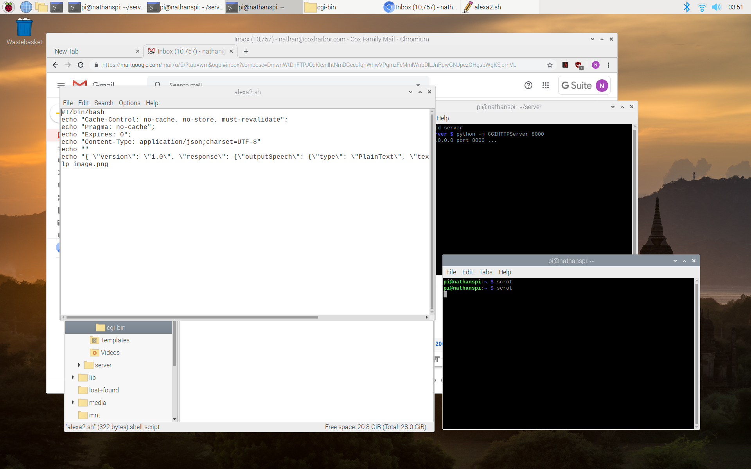
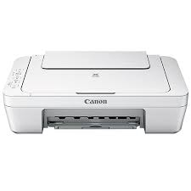
Implementation Details

Slide 8

Result Analysis

Slide 9
Challenges
Setting up a webserver on the Pi with the right permissions.
Enabling the web server to be accessible to the internet.
Creating a second endpoint on our original Alexa skill.
Accessing the JSON object sent to our web server.

Slide 10
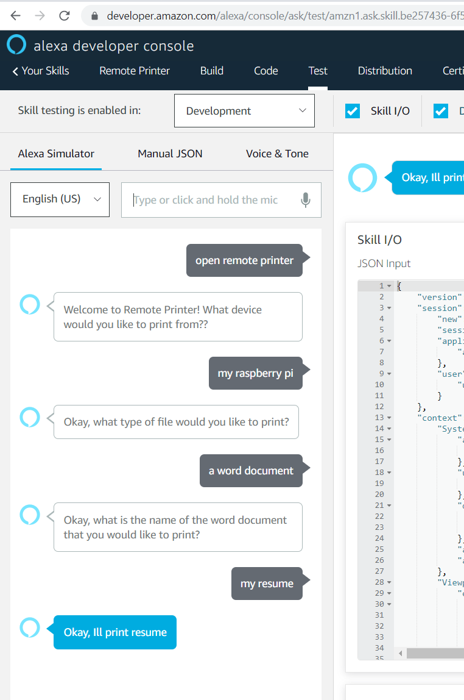

Future Work
Add a file selector function:
For example “alexa print resume.docx” and the pi will run a script that will pass the value.
To do this we used a bash script.
That CUPS command will print the file with the file location.
Notes:
The script is gonna take the filename from the json and then pass the filename as a parameter to the java program which will locate the file and put the file location in a txt file and then the script will take the file location and run the cups command line “lp” command.

Slide 11
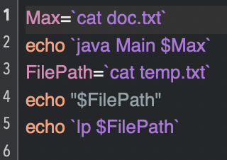
Future Work (Cont’d)
Search sh:

Slide 12
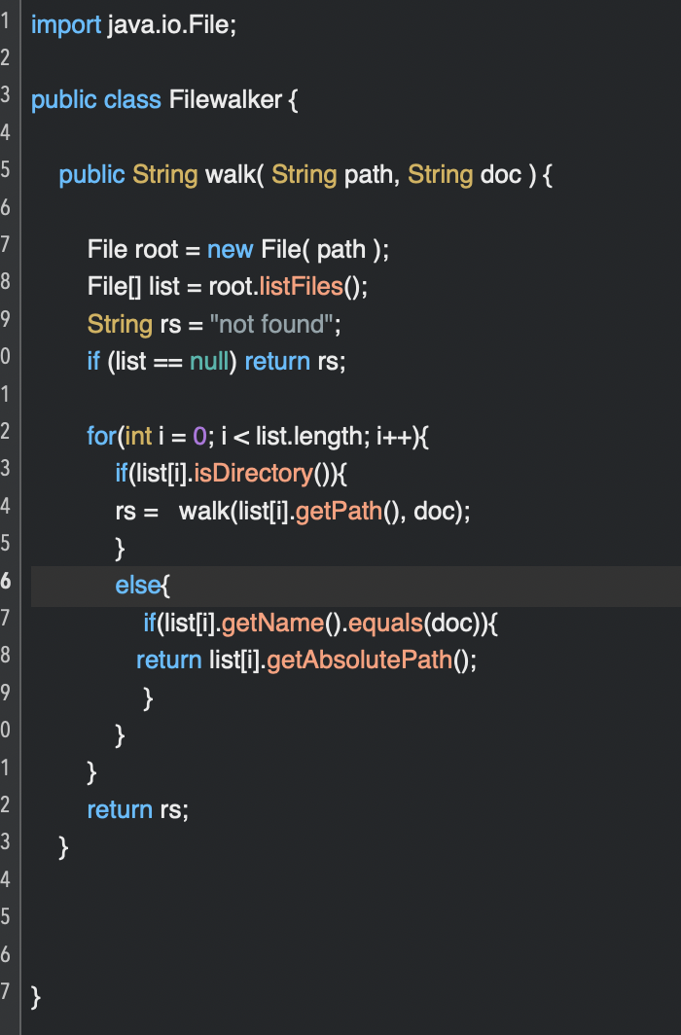
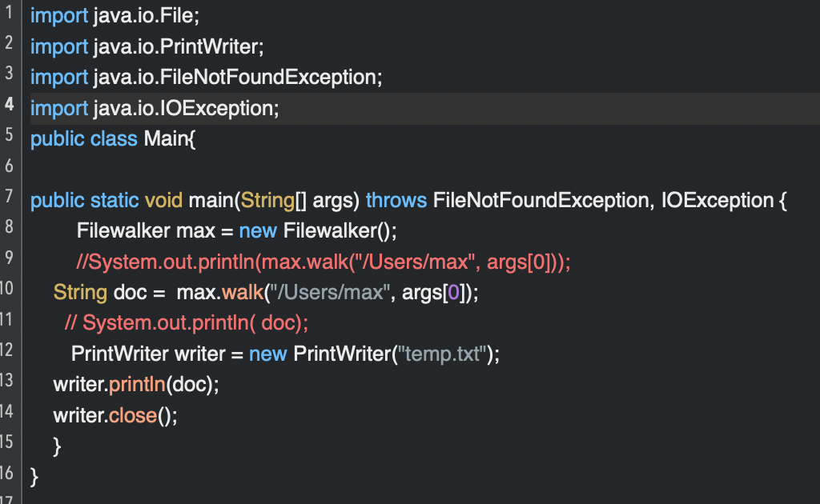
Future Work
Main Java: Filewalker Java:

Slide 13


Questions?

